Slide 1




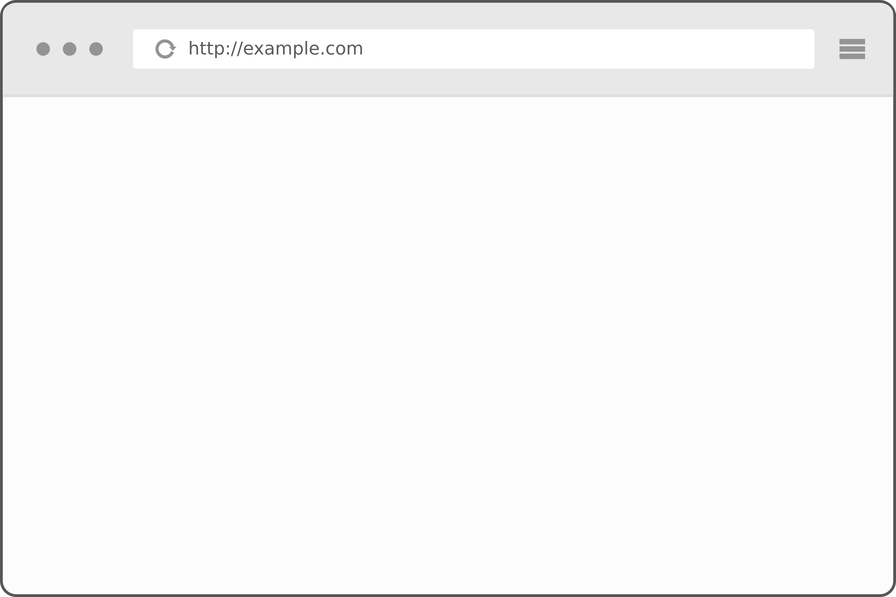










We use programming languages, database systems and frameworks to provide standards compliant, accessible HTML to users browsers. This HTML enables users to achieve their goals. We then enhance the experience with design (using CSS) and behaviour (using JavaScript and modern APIs). This is known as progressive enhancement
Some modern APIs:
File API, History API, IndexedDB, Touch events, WAI-ARIA, Web Storage, Web Sockets, Web Workers, Microdata, Drag and Drop, Canvas, Audio, Video.

Slide 2
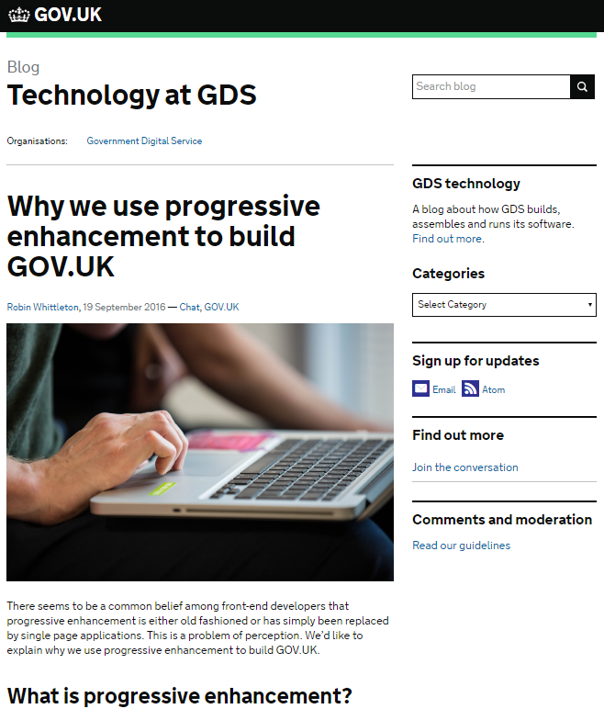
Why progressive enhancement? Because developing for browsers is different
“In traditional software development, you have some say in the execution environment. On the Web, you don’t. I’ll explain. If I’m writing server-side software in Python or Rails or even PHP, one of two things is true:
I control the server environment, including the operating system, language versions, and packages.
I don’t control the server environment, but I have knowledge of it and can author my program accordingly so it will execute as anticipated.
... On the Web, however, all bets are off. The Web is ubiquitous. The Web is messy. And, as much as I might like to control a user’s experience down to the pixel, I understand that it’s never going to happen because that isn’t the way the Web works.”
Aaron Gustafson

Slide 3
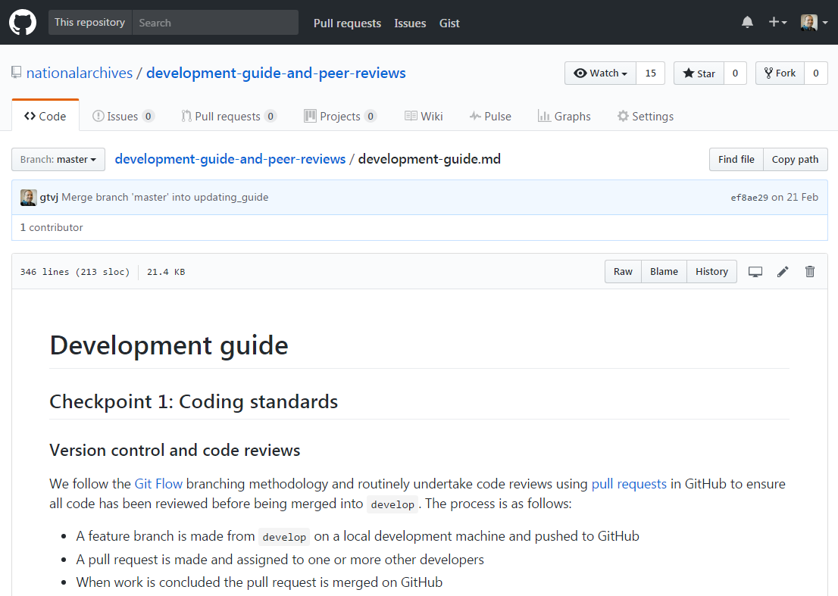
Our living development guide
Providing intuitive, interactive and accessible user experiences with progressive enhancement is a complex task that requires careful thought at all stages of development.
We have therefore published a development guide to support our development teams deliver high quality, inclusive and maintainable digital services while achieving a good balance between innovation and effective use of our development capability.

